Slide 1
Insurance predication
batch_16_project group_20
Create a ML models to predict the ‘Insurance cost’ with minimum MSE and RMSE and maximum R-Square score. Build the following models:
Multiple linear regressor (MLR)
Random Forest Regressor (RFR)
MLR with PCA
RFR with PCA

Slide 2
batch_16_project group_20
Multiple linear regressor (MLR) - PINNINTI BHARGAVI DAANA LAKSHMI
Random Forest Regressor (RFR)- Madiha Nourien
MLR with PCA –Aishwarya k
RFR with PCA - Saurav Singh

Slide 3
Data preprocessing
Step 1: Frame the Problem
Step 2: Collection of Raw Data
Step 3: Process the Data for Analysis and Encoding
Step 4: Explore the Data
Step 5: Data Cleaning
Step 6: Perform in-depth Analysis

Slide 4
Multilinear Regression
First, we need to import libraries that we need to complete the project.
The insurance.csv file includes 1,338 examples consists of variables like age, sex, bmi , children, smoker, region and charges.
As we already downloaded, we will use the read.csv() function to load the data for analysis.
Here, sns.heatmap(data.corr()) function is used to figure out the relationship between attribute more clearly and visualize them.

Slide 5
Multilinear Regression
The value_counts returns the count of unique item in a pandas data frame.
Assigning x and y by using data.iloc.values function, to slice the data over both rows and columns.
And label encoder is used to normalize labels, so the function labelencoder.fit_transform() is used to transform non numerical labels to numerical labels.
Data.head() returns top 5 rows of data frame and stores in a new variable.
And scatter() plot is used to observe relationship between variables and uses dots to represent the relationship between them.

Slide 6
Multilinear Regression
By importing metrics we predict MAE,MSE,RMSE.
MAE = 4010.3218839398587
MSE = 33693652.01080252
RMSE = 5804.6233306565655
Finally, create a linear regression model for x and y and find out the regression value or r-square value by using certain libraries.
Linear regression = 0.7442085378400611
R2 score = 0.7601485628002146

Slide 7
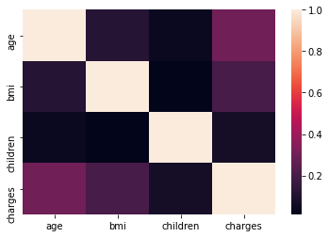
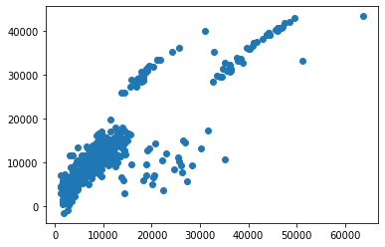

Slide 8
Random forest regression (RFR)
Steps to create Data Model using RANDOM FOREST REGRESSION:
1. Download and explore the dataset.
2. Prepare the dataset for training.
3. Create a Regression model.
4. Train the model to fit data.
5. Make predictions using the trained model.

Slide 9
Random forest regression (RFR)
Importing libraries like :Numpy, pandas, Matplotlib, standardscaler ,labelencoder etc
DATA PROCESSING:
Load the Data and Explore the Data set.
Reading the Data set :insurance.csv, using pd.read()function to load the data for analysis.
The value_counts() reutrns the count of items and assigning x and y by using data.iloc.values function to slice the data over rows and columns
Using Data.head() returns the value of data frame & Scatter() plot to observe relation.

Slide 10
Random forest regression (RFR)
MODEL SELECTION:
Importing the Libraries such as sklearn.model_selection, ensemble,Random forest regression, accuracy score StandardScaler.
VALUES:
TRAINING SET PREDICTION SCORE : 0.9757867485085552
TESTING SET PREDICTION SCORE : 0.8303030611618449

Slide 11
Random forest regression (RFR)
MODEL EVALUATION:
Importing libraries like mean_squared_error, r2_score
Evaluate Prediction Model using MSE and R2-SCORE
VALUES:
RMSE-Random Forest : 4777.75 (square-rooted)
R2-Random Forest : 0.83
MSE-Random Forest : 22826857.22

Slide 12
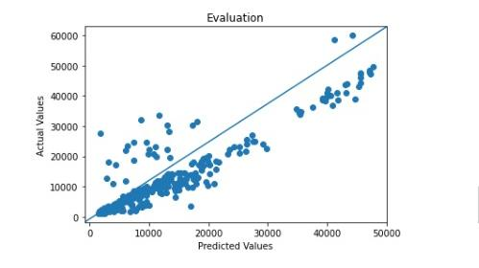
Random forest regression (RFR)
GRAPH:
Importing matplotlib pyplot as plt with the Tittle of the graph as Evaluation
x-axis as Predicted values,
y-axis as Actual values.

Slide 13
Model evaluation
Evaluated prediction model using MSE by
rf_mse = mean_squared_error(Y_test, predict)
Evaluated prediction model using R2-Score by
rf_r2 = r2_score(Y_test, predict)
Evaluated prediction model using MSE
rf_mse = mean_squared_error(Y_test, predict)

Slide 14
pca(principal component analysis)
Create a model with following steps:
1.Getting the dataset
2.representing the data into structure
3.Standardizing the data
4.Calculating the Covariance of Z
5.Calculating the Eigen Values and Eigen Vectors
6.Sorting the Eigen Vectors
7.Calculating the new features Or Principal Components
8.Remove less or unimportant features from the new dataset.

Slide 15
pca(principal component analysis)
Importlibrarieslike sklearn.decomposition import PCA,metrices,matplotlib,mean_squared_error,r2_score,math.
Standize the feature of the model using standardized = StandardScaler() and
scaled_data = standardized.fit_transform(df1).
Determine the principal components
And select the feature reduction.
pca.fit(scaled_data)
x_pca = pca.transform(scaled_data)

Slide 16
pca(principal component analysis)
Varience: The explained variance tells you how much information (variance) can be attributed to each of the principal components.
ev = pca.explained_variance_ratio_
Visualize the code And have done data selection
Graph shows prediction value, actual value and evaluation

Slide 17
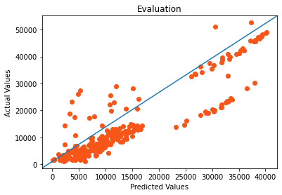
pca(principal component analysis)
GRAPH FOR MLR :
Importing matplotlib with the Title of the graph as Evaluation
x-axis as Predicted values,
y-axis as Actual values.

Slide 18
pca(principal component analysis)
RESULT FOR MLR :
TRAINING PREDICTION SCORE : 0.7366969327839583
TESTING PREDICTION SCORE : 0.7993609962127467
RMSE-RANDOM FOREST : 5650.46 (square-rooted)
R2-RANDOM FOREST : 0.80
MSE-RANDOM FOREST : 31927677.11

Slide 19
pca(principal component analysis)
GRAPH FOR RFR:
Importing matplotlib with the Title of the graph as Evaluation
x-axis as Predicted values,
y-axis as Actual values

Slide 20
pca(principal component analysis)
RESULT FOR RFR :
RMSE-RANDOM FOREST : 5009.92 (square-rooted)
R2-RANDOM FOREST : 0.84
MSE-RANDOM FOREST : 25099313.09
TRAINING PREDICTION SCORE : 0.9662946235047881
TESTING PREDICTION SCORE : 0.8405729935224402

